Slide 1

College Improvement
Using Machine Learning to Improve the Lives of Students and Universities

Slide 2
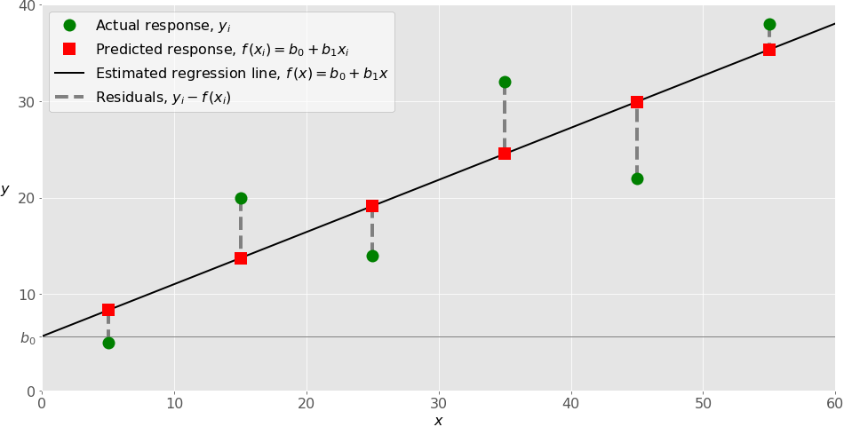
How to Improve a University
To use Regression Models to predict the ‘Score’ of a college. The score is
ŷ = (x / y) + 0.5(w/z)
Where x is the average salary of a graduate after 10 years, y is the average debt. W is the enrollment size, and z is the count of students with employment
The features used in prediction will be controllable by the University such as Faculty Salary, Admission Rate, and Average Instructional Expenditures per Student

Slide 3
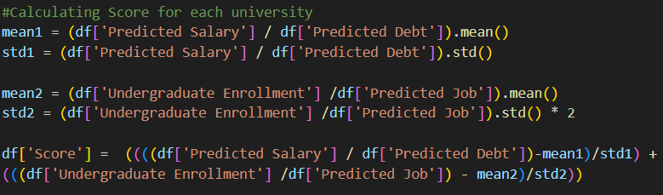
Score is Standardized and Weighted

Slide 4
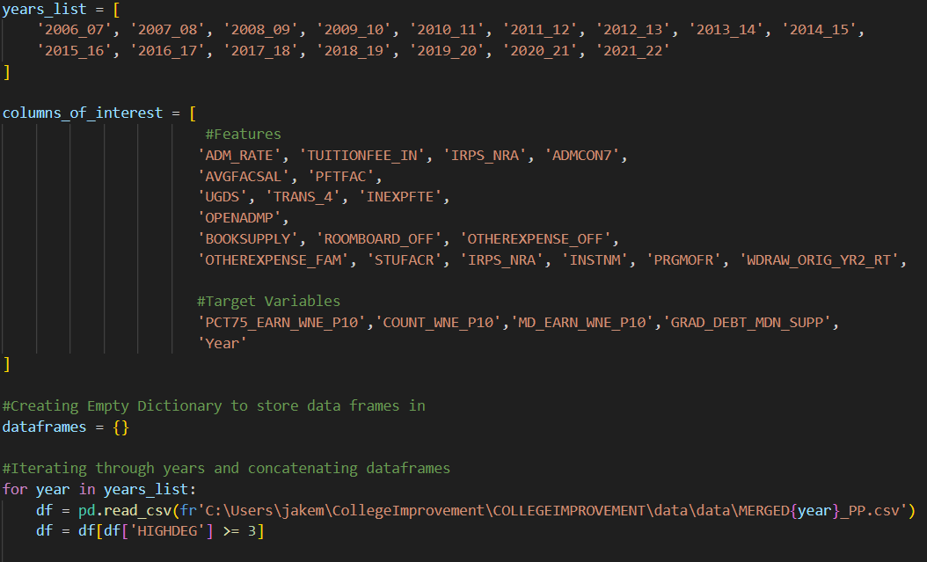
Data: Filtered Years above 2006 and Degree Type (Bachelors and Above Only)

Slide 5
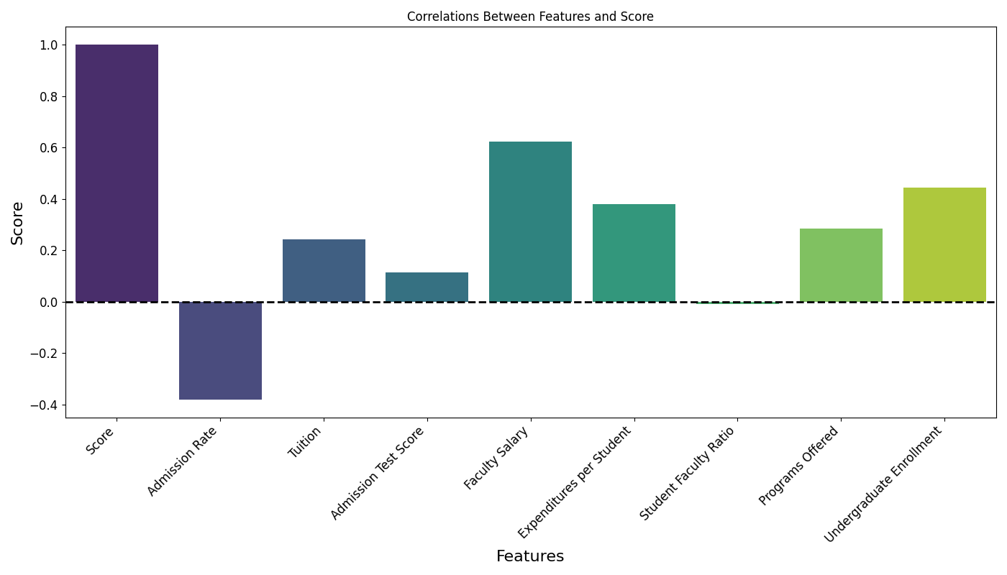
Results – Correlations of Features with Score
High Scoring Universities correlated with higher faculty salaries, more spending for instruction per student, and more programs offered
Low Scoring Universities correlated with high admission rates.
Student to Faculty ratio a negligible feature in predicting score

Slide 6
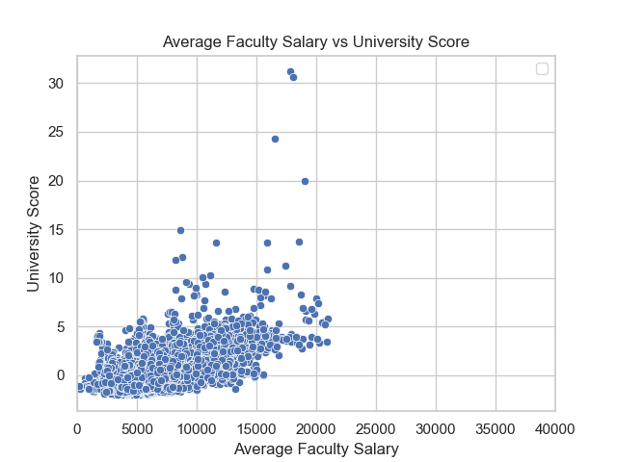
R correlation coefficient score of .587. Considered a moderate positive correlation

Slide 7
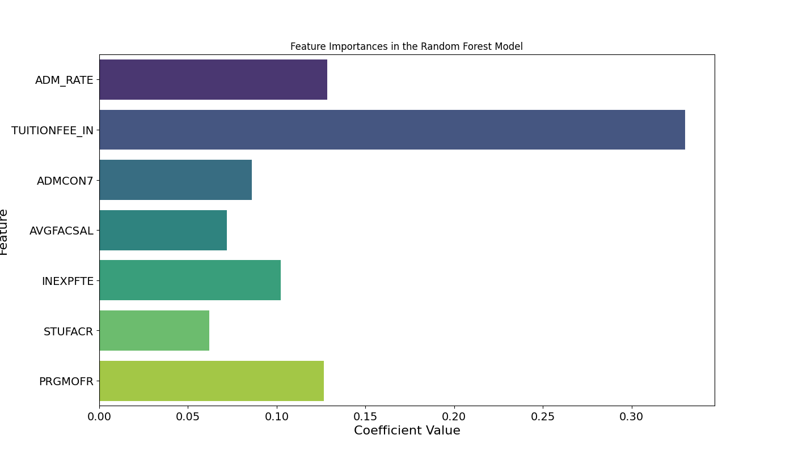
Important Features: Higher Value = Earlier Split with more Gain

Slide 8
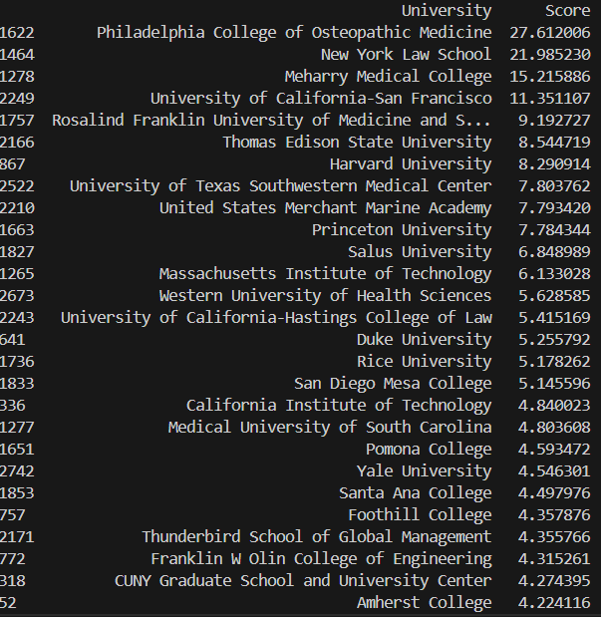
Top Scoring Colleges
Medical Schools, Law Schools, Military Academies, and Ivy Leagues

Slide 9
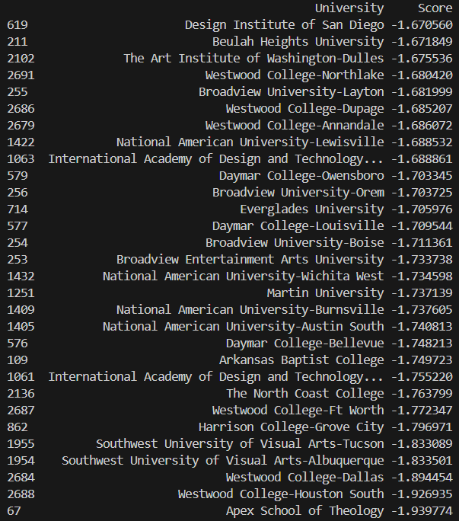
Lowest Scoring Colleges
Art Schools, Design Colleges, Theology Schools

Slide 10
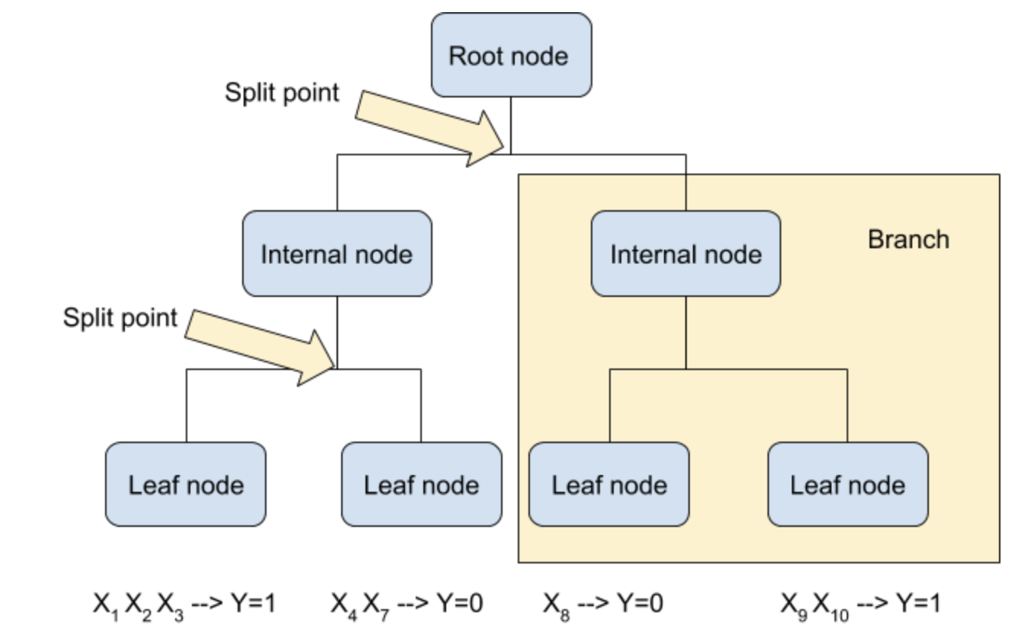
What about Predicting Score from Features for Duquesne?

Slide 11
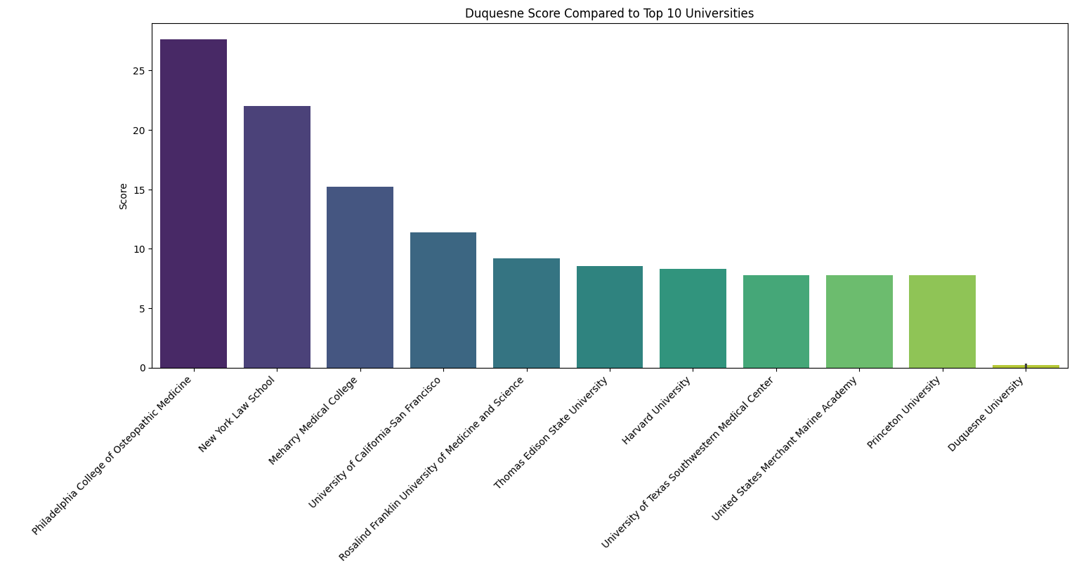

Slide 12
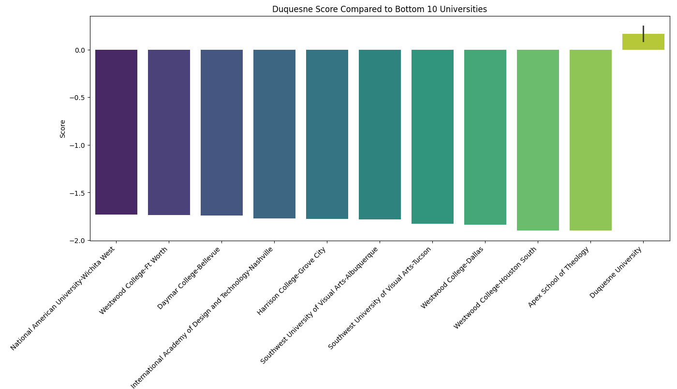

Slide 13
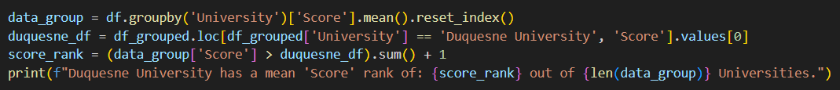
Pittsburgh College Totals

Slide 14
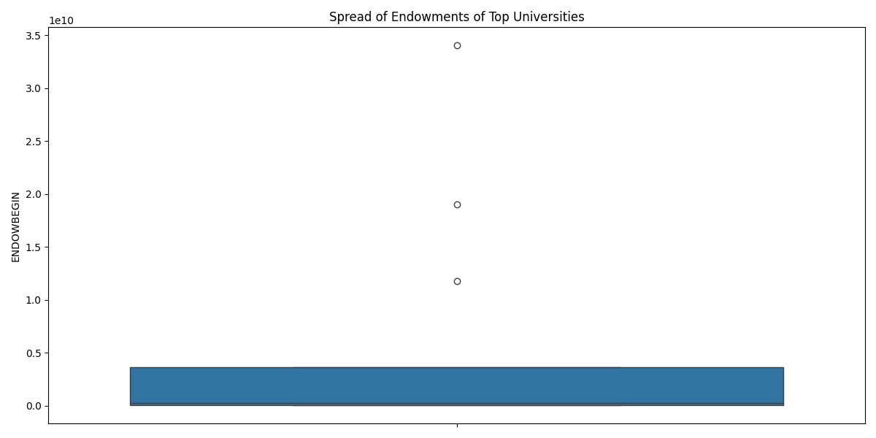
Endowments
Some Colleges Receive more money than others, so to maintain proportionally I’ll show financial metrics with and without outliers (3 outliers being MIT, Harvard, and Princeton)
Average Duquesne Endowment: $247,335,875.00
Average Endowment of top 30 universities Excluding Outliers: $282,327,970.86

Slide 15

Improving Duquesne
Top 30 Universities Average Programs: 25.19, Duquesne: 15.345
Increase number of programs by approximately 10
14.2% of top 30 degrees are engineering, Duquesne: 0.3%
Offer a more robust engineering program to offer better paths for students, engineering in high demand!
Top 30 Universities Instructional Expenditures per Student $50,201.86. Without outliers $27,037.0, Duquesne: $10,748.12
Increase Spending in the classrooms rather than on amenities to increase skill development of students

Slide 16

Improving Duquesne
Top 30 average faculty salary: $12,515.41,
Without Outliers: $11,459.15
Duquesne: $8,658.5
Top Universities pay faculty with a higher proportion to their endowment. Duquesne should pay more to professors to attract better talent and incentivize current employees.
Top 30 average admission rate: 20%, Duquesne: 73.5%
Be more selective in admission to attract high quality students

Slide 17
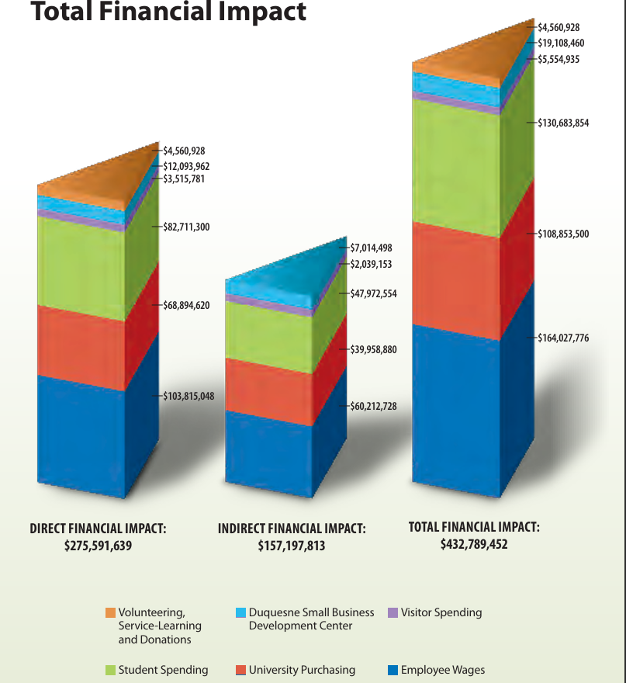
Duquesne’s Spending
Allocate more of purchasing expenses to employee wages
Reallocate spending within the “Student Spending”

Slide 18
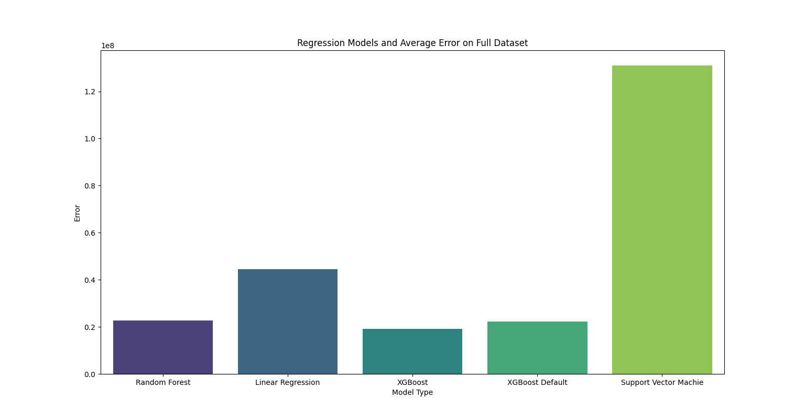
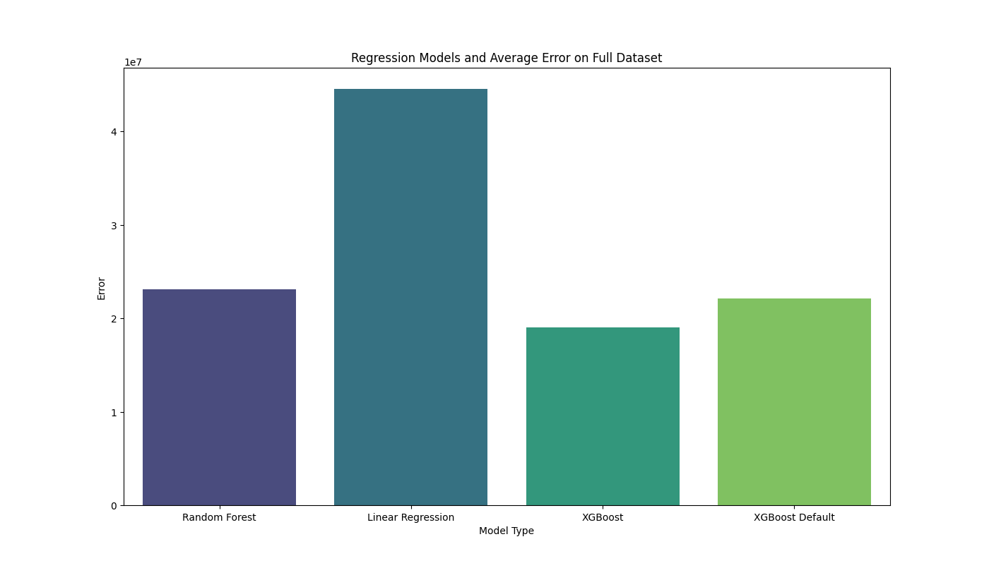
Best Model is XGBoost – Mean Square Errort

Slide 19
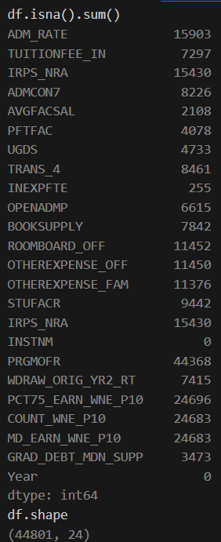
Challenges
Missing Values!

Slide 20
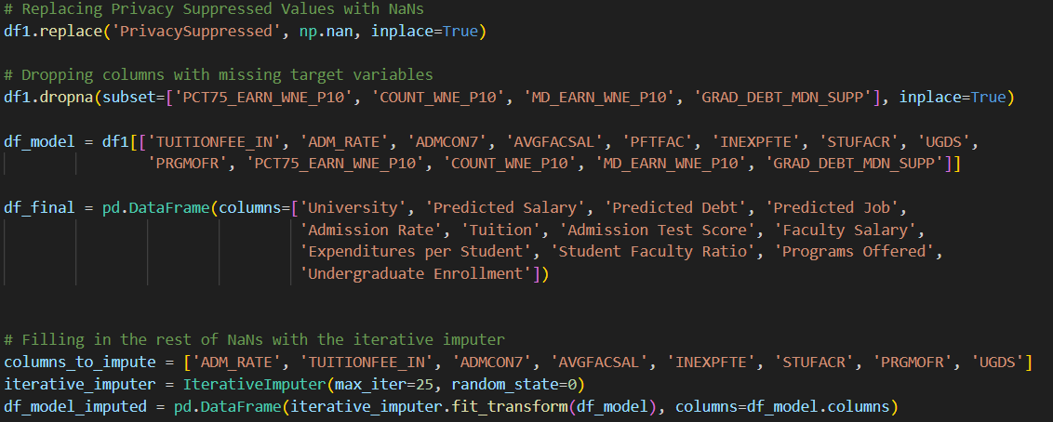
Challenge Solution? Imputation & Feature Selection

Slide 21
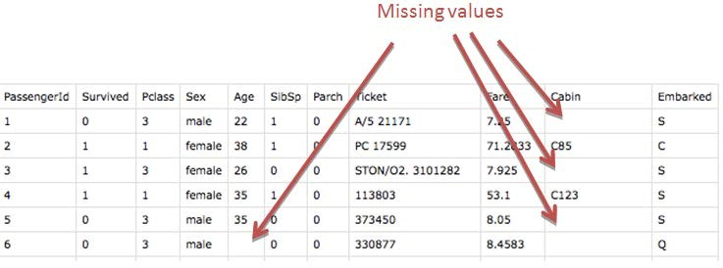
Best Imputation: Iterative Imputer (Supervised Learning to Find Missing Values from Other Columns)
Better than mean value imputation, KNN supervised imputation, and XGBoost built in NaN handler

Slide 22
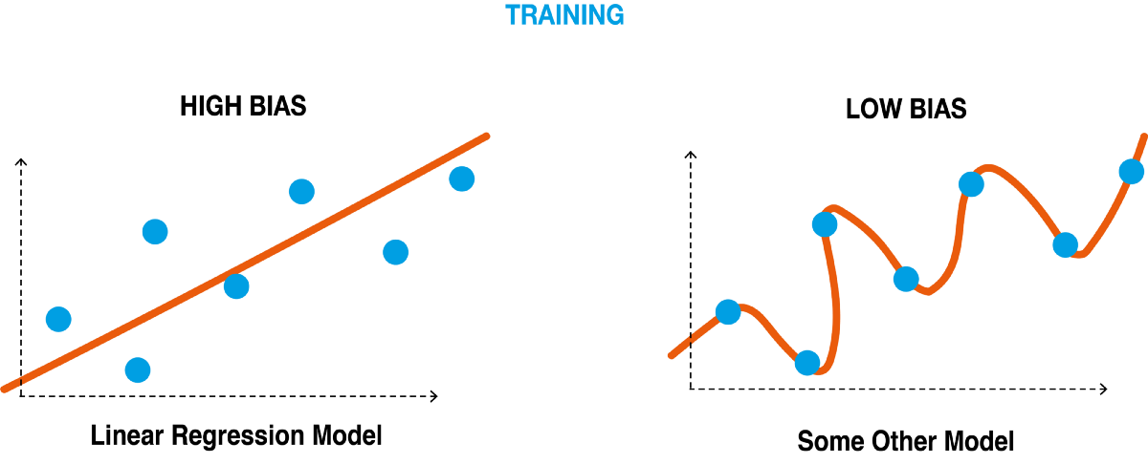
Challenges: Poor Hyperparameters

Slide 23
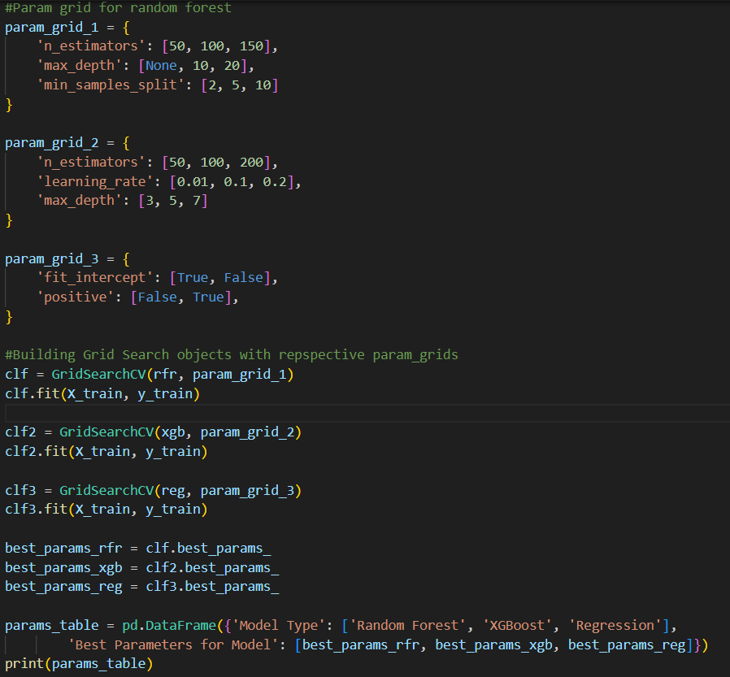
Challenge Solution? Grid Search!

Slide 24
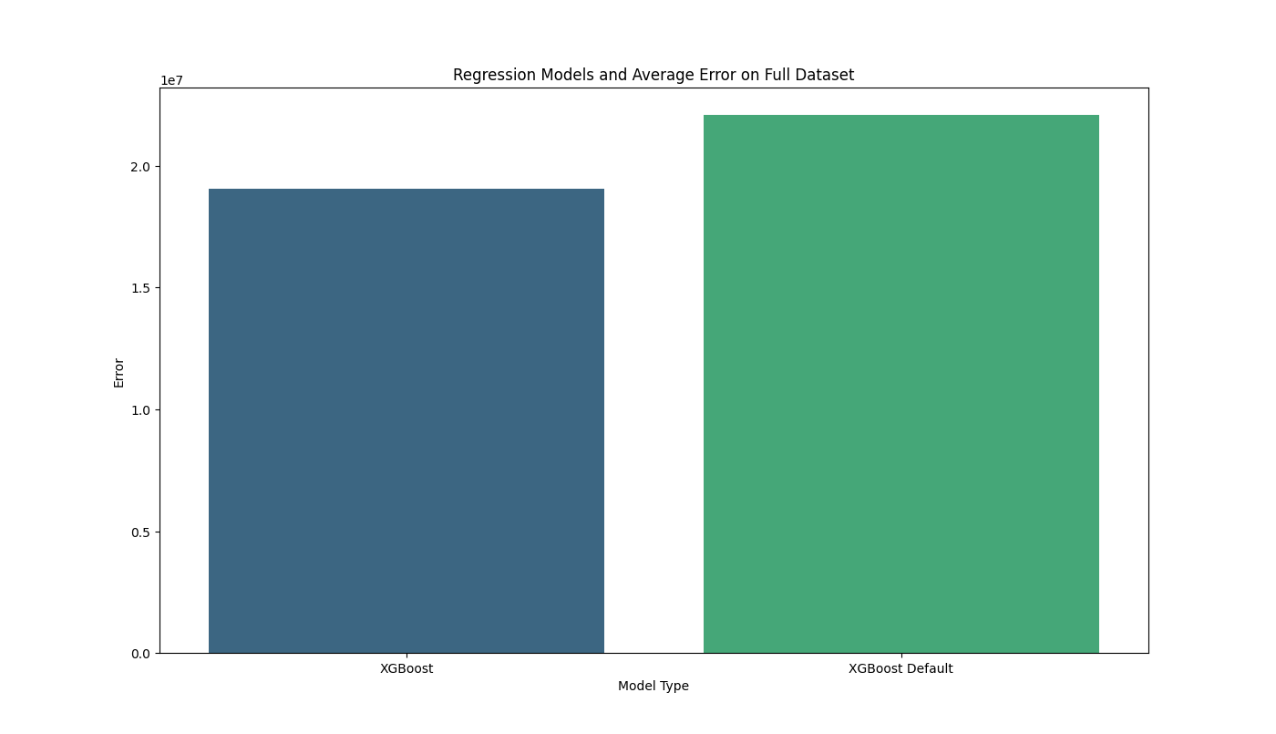
Grid Search Works – Lower Error with Best Parameters

Slide 25

Conclusions
Regression Techniques applied to big data can produce useful insights
My tool can be used as a resource for students to make smart financial decisions when choosing colleges
Correlations can also be used by Universities to inform policy decisions
Real world data messy and challenging!
Patience + Perseverance essential in Machine Learning

Slide 26
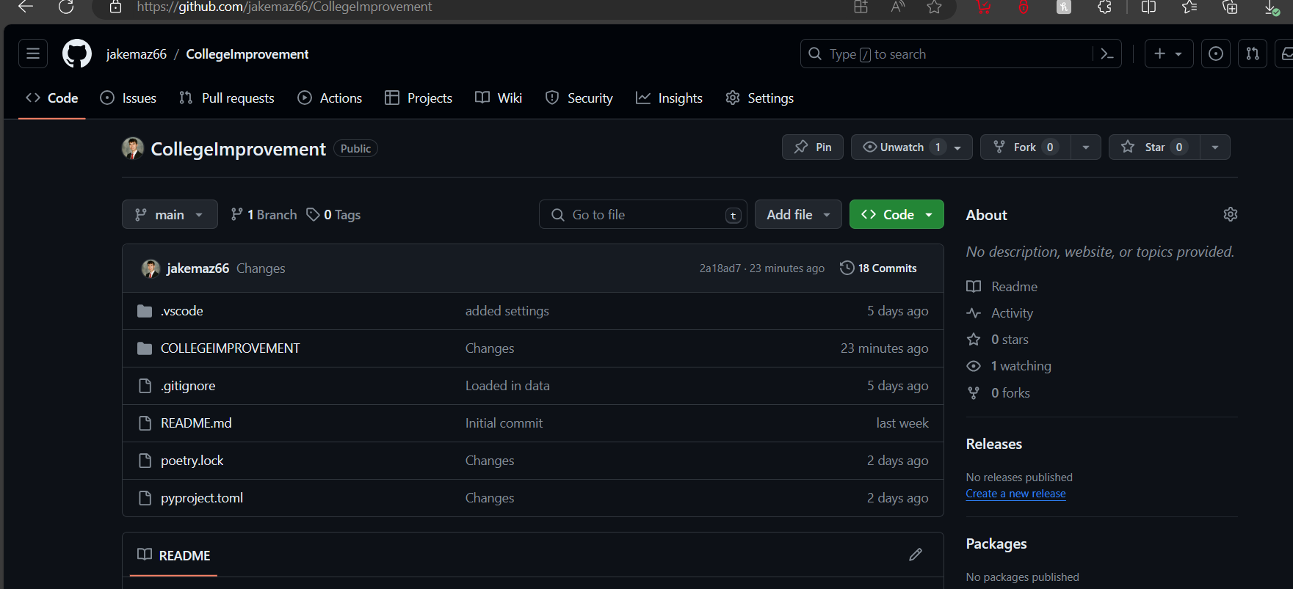
Want to Find out More: Checkout Repo!

